Slide 1
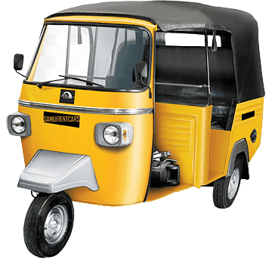
Namma Yatri
Open Mobility Challenge

Slide 2

Theme: Namma Yatri
Problem Statement 2: Booking Without App
The ability to book a Namma Yatri auto could open up more demand. Build innovative tech solutions to let customers book an auto without installing the app - E.g. website, WhatsApp, SMS, Phone etc. This will cater to users who are uncomfortable or unwilling to use Apps.

Slide 3

Intro
Booking an auto-rickshaw can often be a cumbersome process, especially for customers who do not have access to a mobile app. To solve this problem, we have developed an innovative solution that allows customers to book an auto-rickshaw through the popular messaging platform, WhatsApp. Our solution enables customers to easily book an auto, receive auto-confirmation and booking status updates, cancel or modify bookings - all via WhatsApp. This project aims to provide a convenient and efficient transportation solution for customers, while also increasing revenue and efficiency for auto drivers and owners.

Slide 4
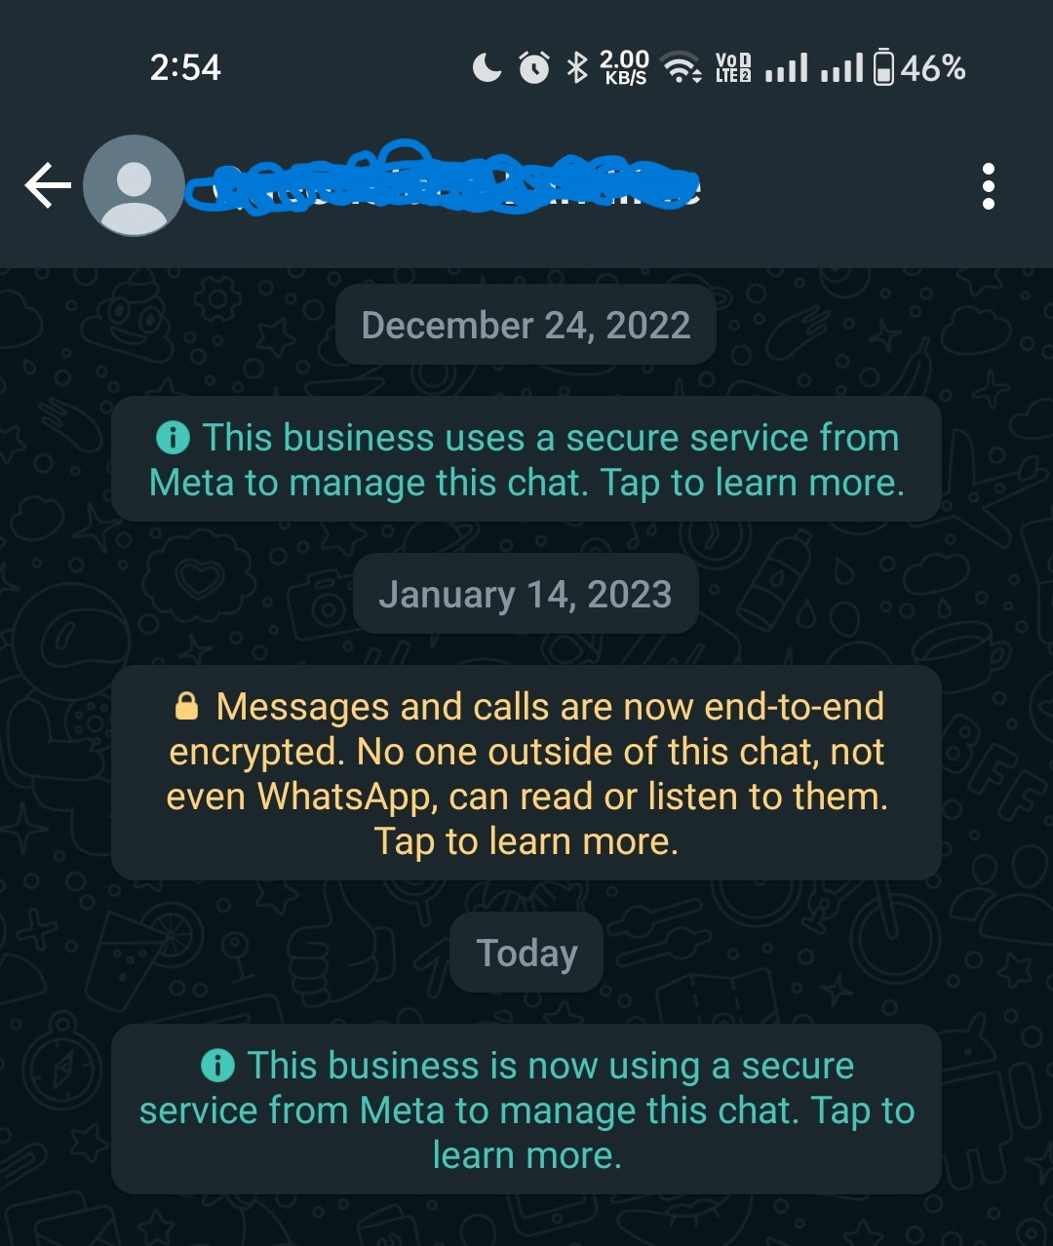
How does this works?
This can acheived by using WhatsApp’s official Business API (Cloud API) from Meta. Using this API we can easily send and receive any kinds of message from the user enabling the customer to book ride with their comfort.

Slide 5
Customer POV

Slide 6
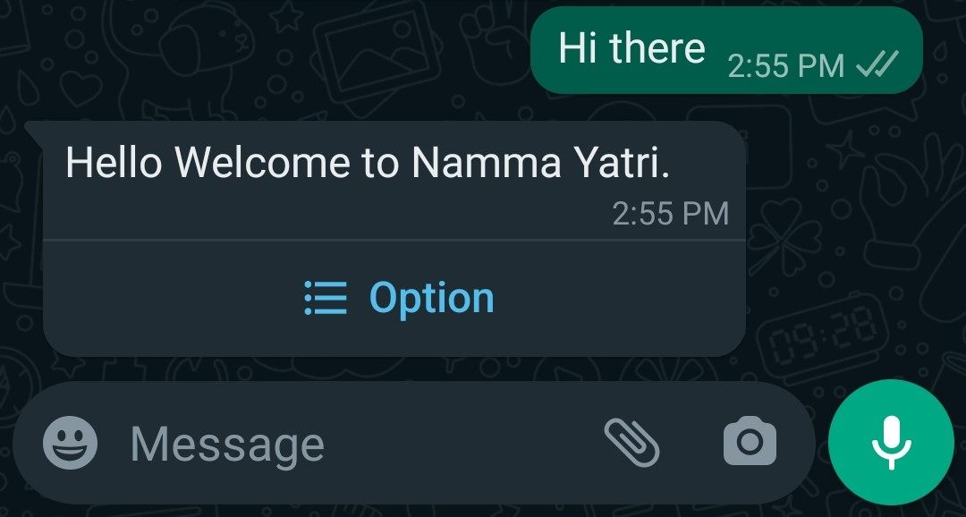
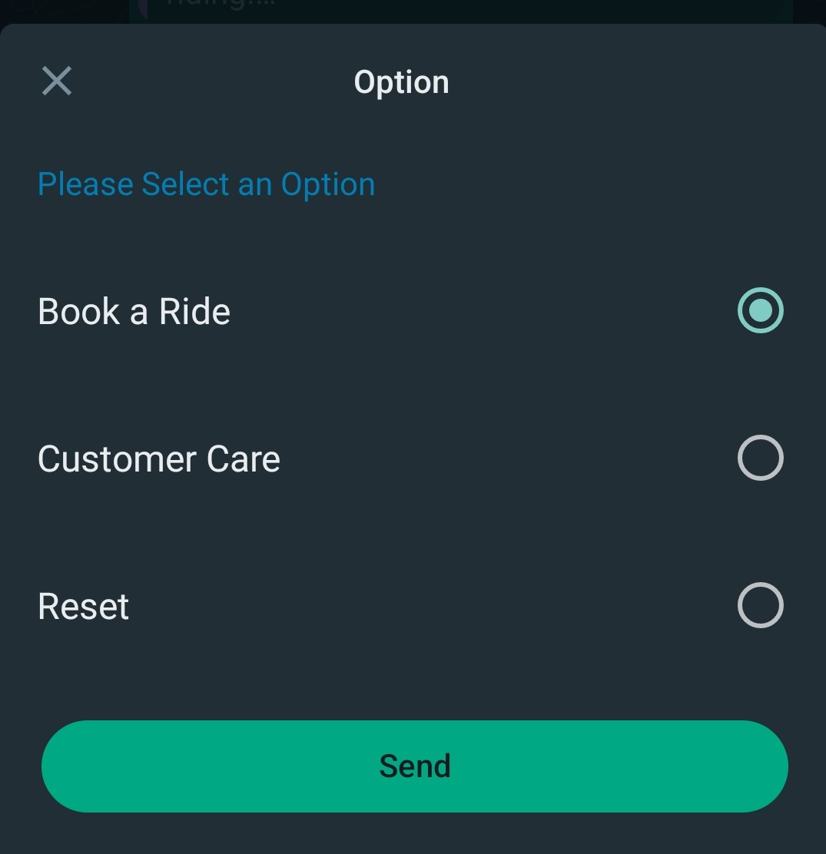
Step 1: The Customer Initiates the Conversation
The Customer will start a conversation to book a ride to the respective mobile number.
The Server Responds with a Menu of Options in which the customer can select any.

Slide 7
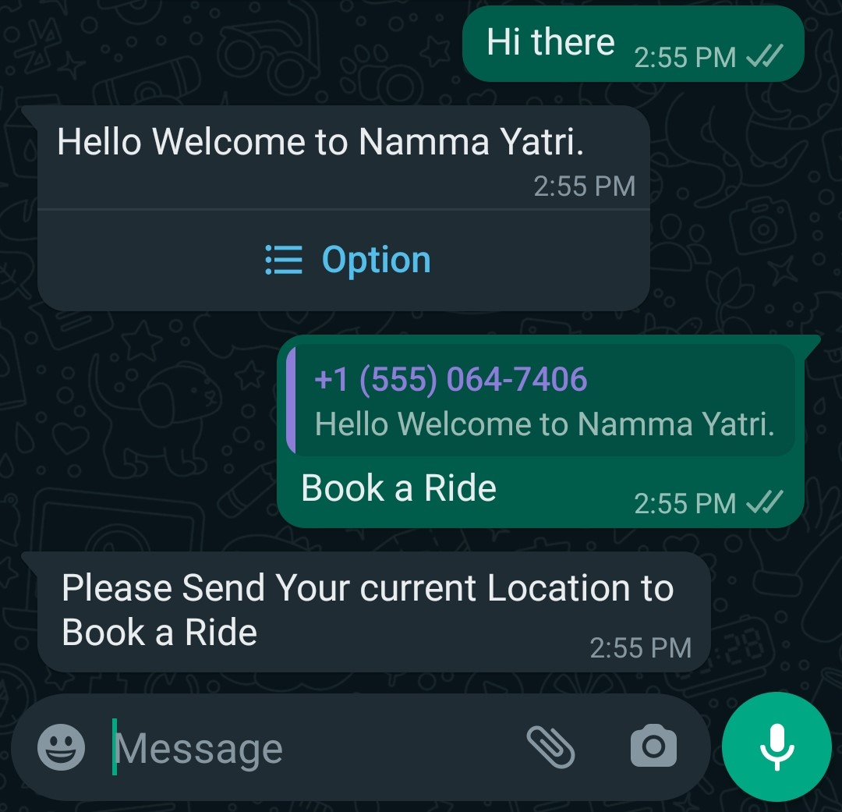
Step 2: Requesting for current Location
Consider the customer chooses to Book a Ride.
Then the server responses by requesting for the users current location.
Using this the drivers will be able to get to the customer.

Slide 8
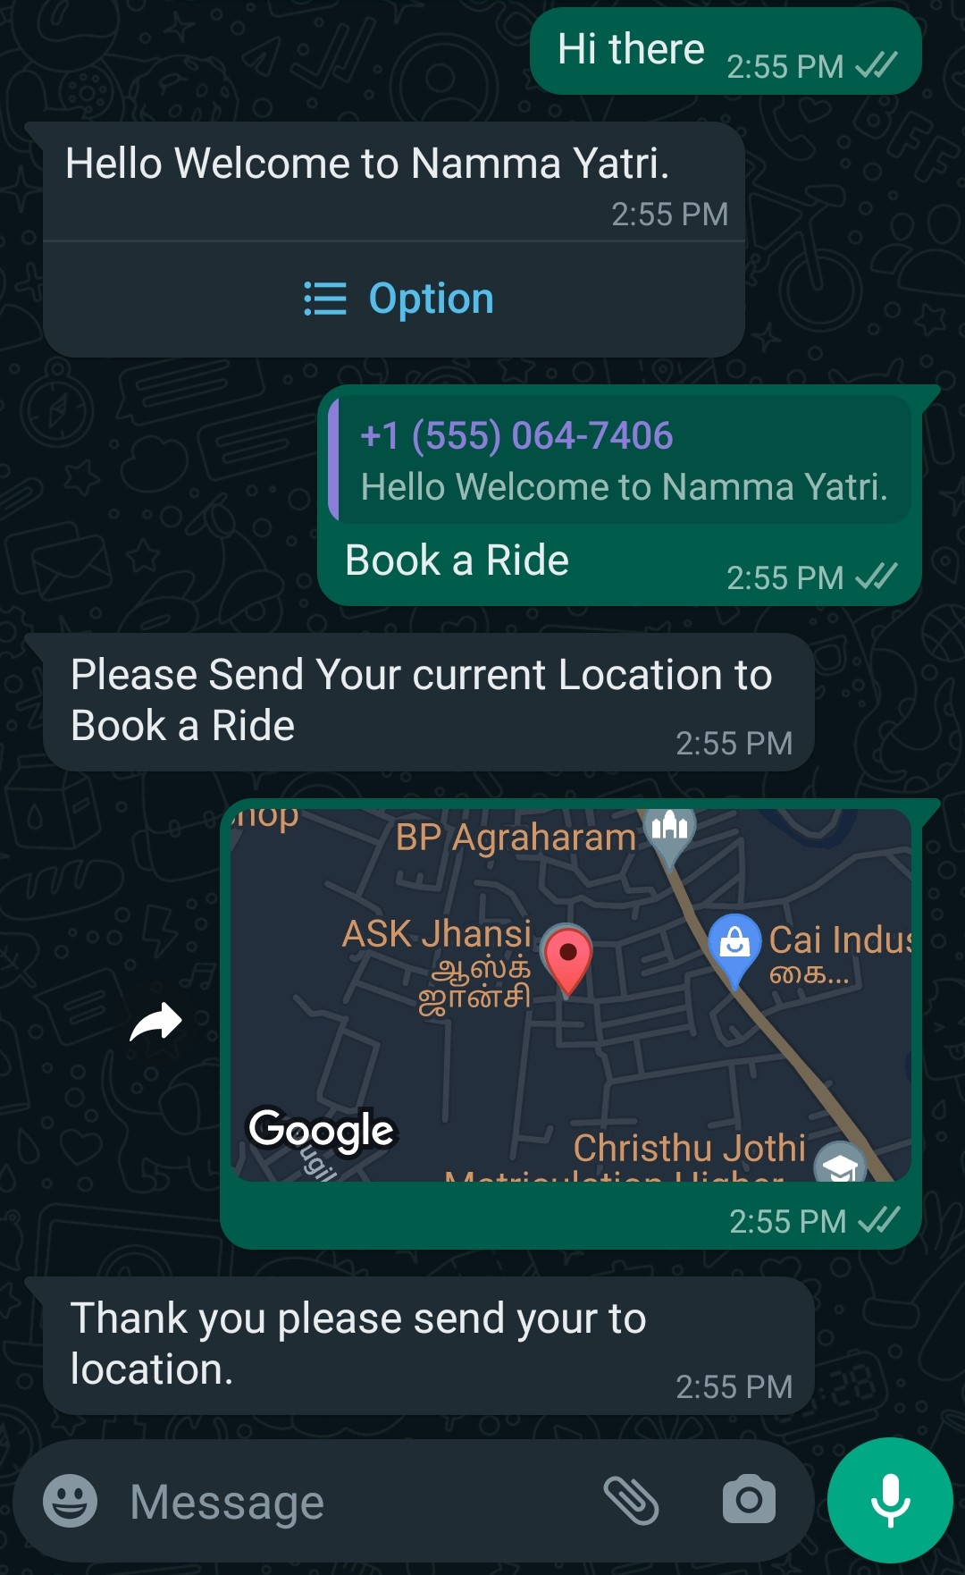
Either the customer sends the current location or else the location of pick up.

Slide 9
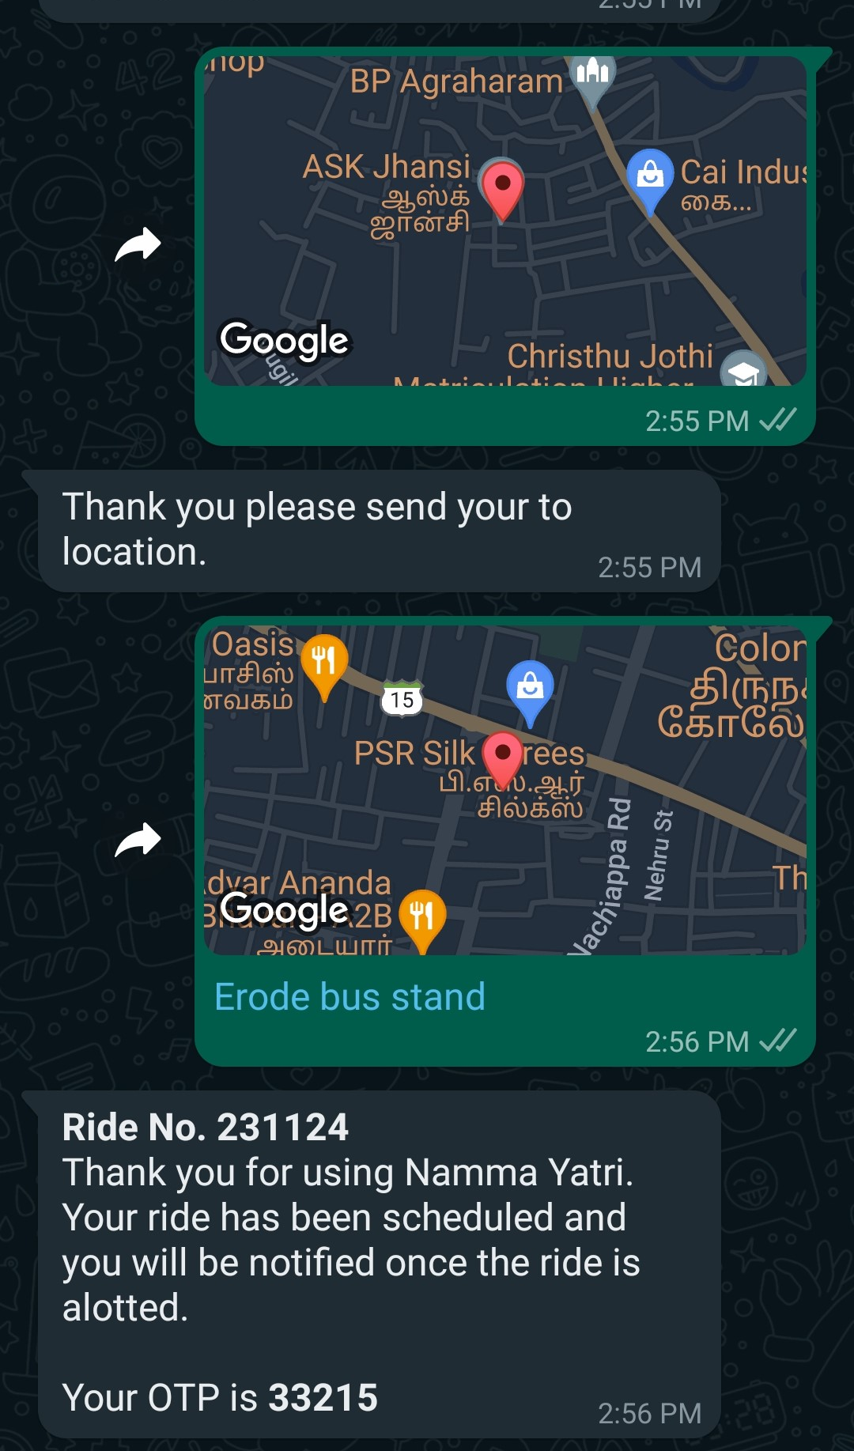
Step 3: Requesting for to Location
The Customer responds with the to location.
A new record (ride) in the database containing from location, to location, unique ride no, otp, mobile no is created.
The database will hold all the information about all the rides.

Slide 10
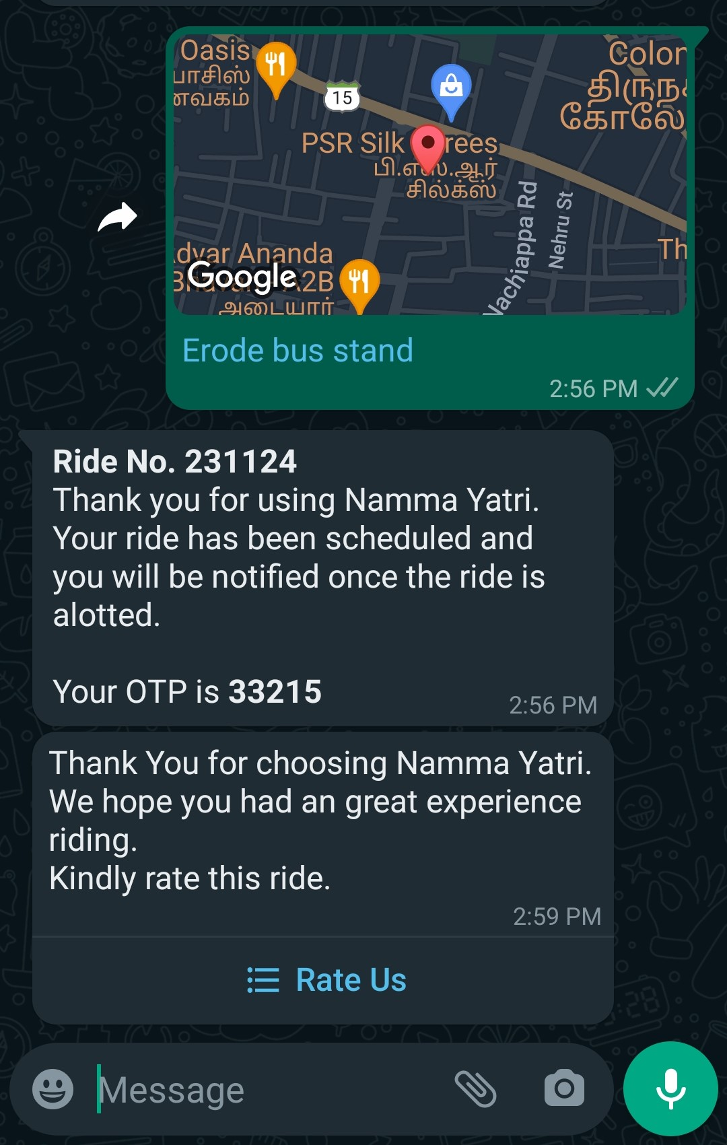
Step 4: Complete the ride
Once the driver marks the ride as completed the server will send a Thank You message and rate us message to the customer.

Slide 11
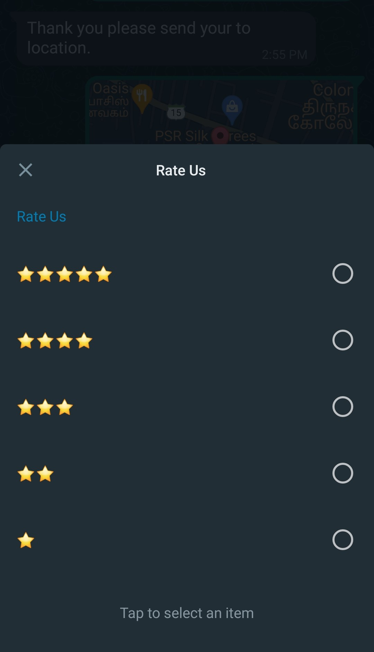
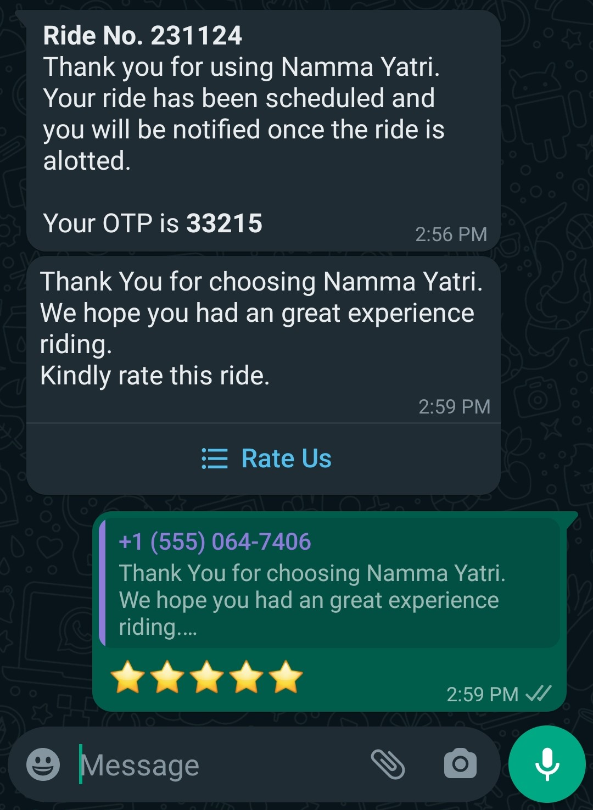
The customer will have the option to select star ratings from 1 to 5.
Consider the customer selects 5 star rating, the rating will be save into the database along with the order.

Slide 12
Driver POV

Slide 13
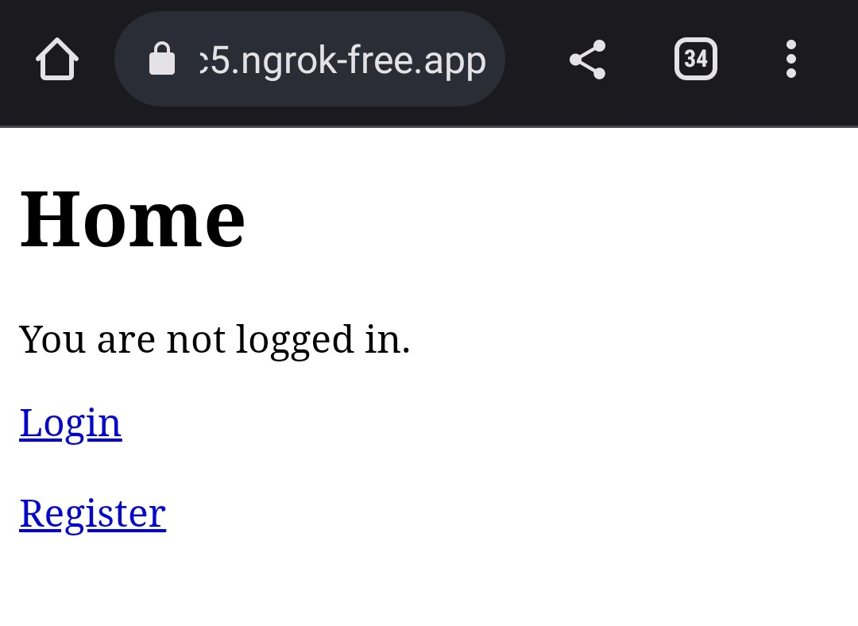
Step 1: Dashboard
All the drivers are able to access the dashboard via example.com/drivers
They will have the options to login and register initially.
(Replace example.com with the domain name that the website is running.)

Slide 14
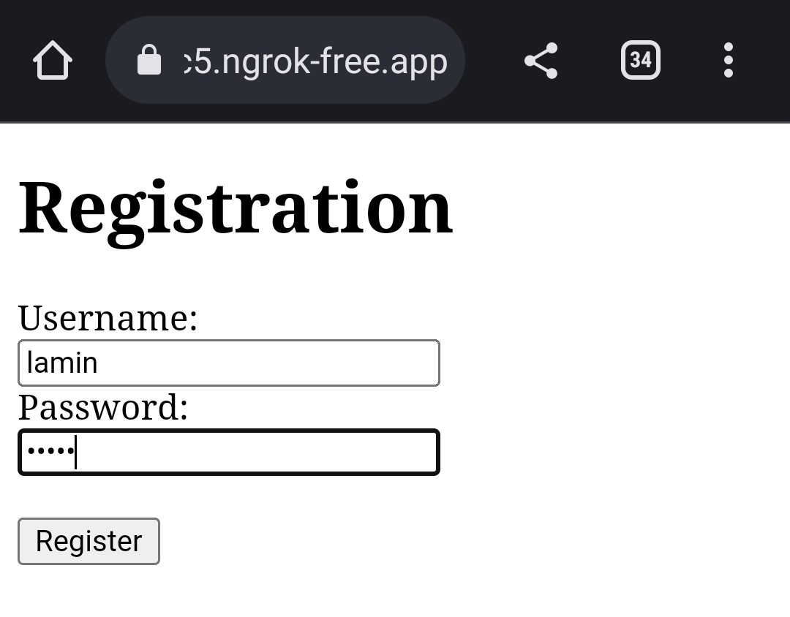
Step 2: Register Driver
New Drivers can register themselves by clicking on the Register button and creating a new user login.
(This MVP just contains fields for username and password, It can be developed further to get driver name & details, Vehicle details etc..)

Slide 15
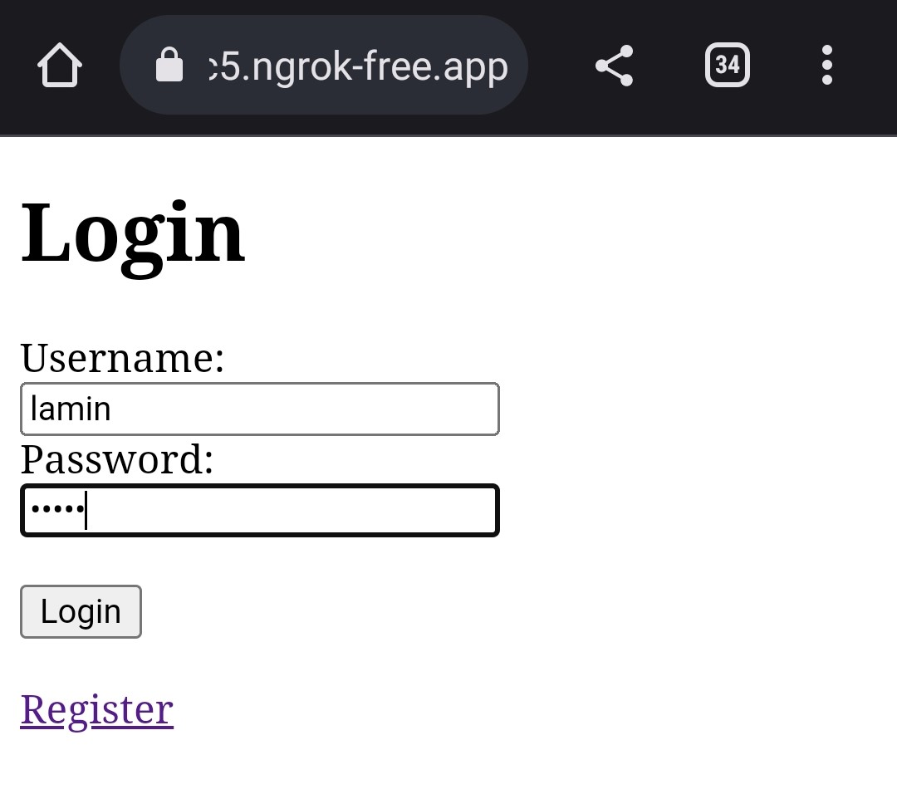
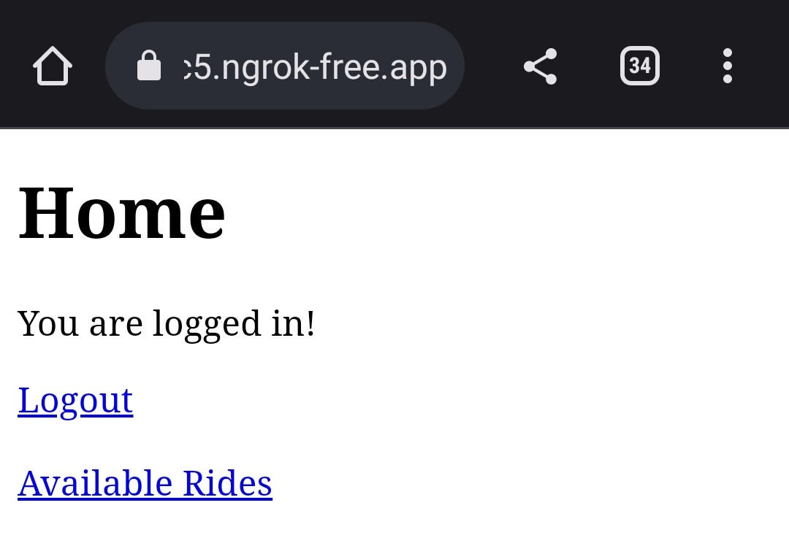
Step 3: Login Driver
After the Driver registers via the registration page they can login by providing the correct credentials.
Each driver will have a seperate login to pick rides.
On successful login the driver will be able to logout or view the available rides.

Slide 16
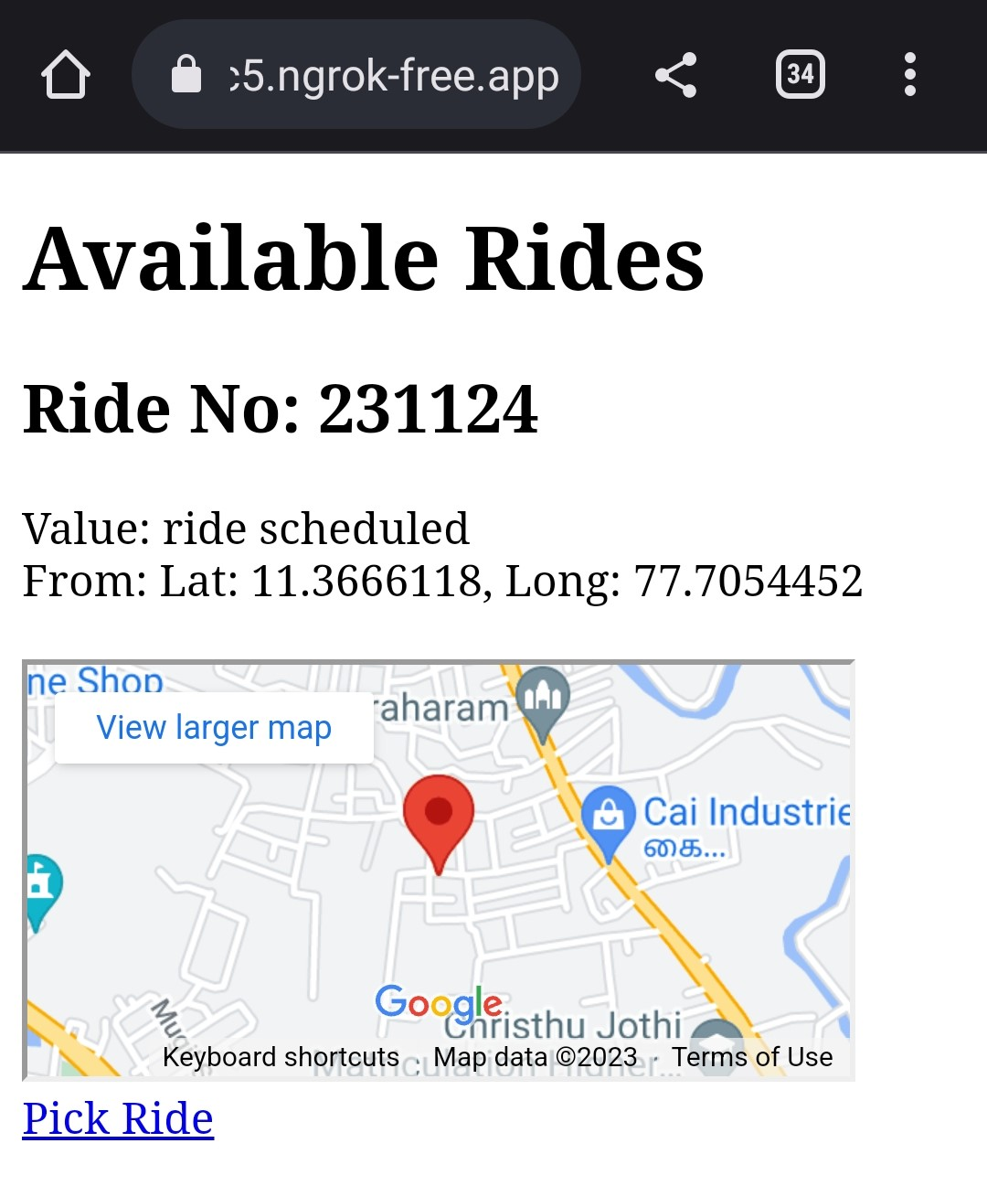
Step 4: Available Rides
The Available Rides Page contains all the rides one by one.
Each ride will have :
A value which tells about the status.
Latitude and Longitude of the from location.
An iframe of maps to view the location, it can also be enlarged or opened in maps app.
Pick Ride Option which allocates the ride.

Slide 17
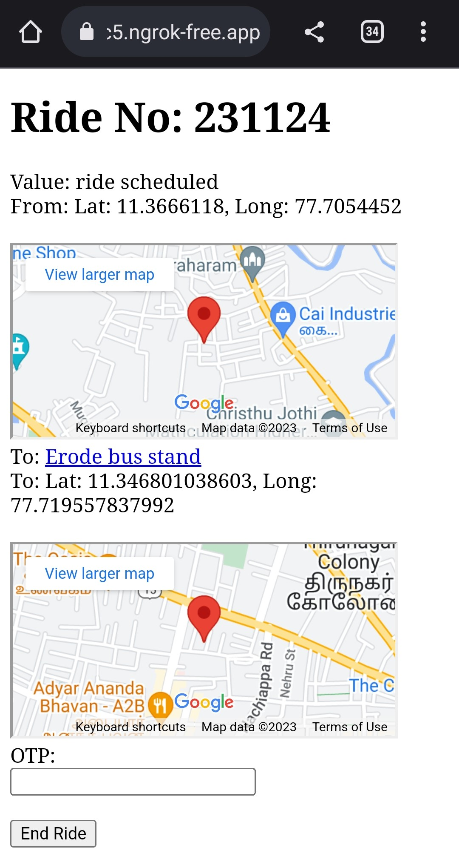
Step 5: Pick Ride
If the ride is picked then the following details will be displayed:
From Latitude, Longitude, Map
To Latitude, Longitude, Map
OTP field to end the ride
(In All rides page to location will not be displayed, It will be displayed only if a driver picks the order.)

Slide 18
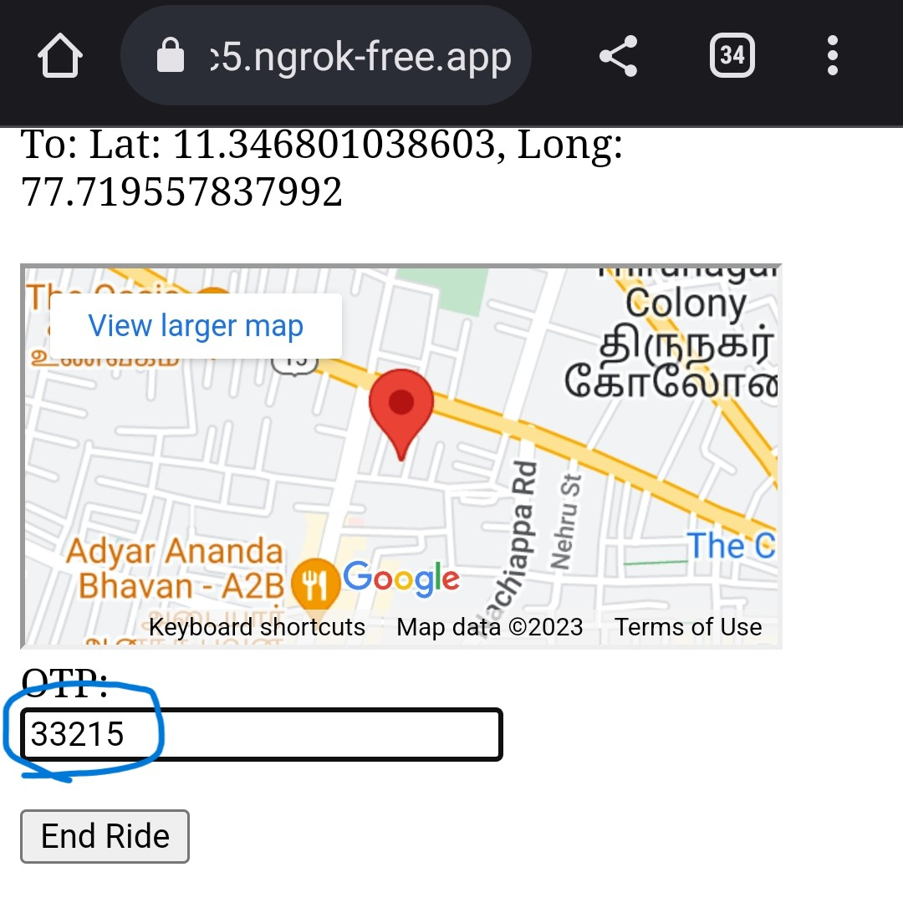
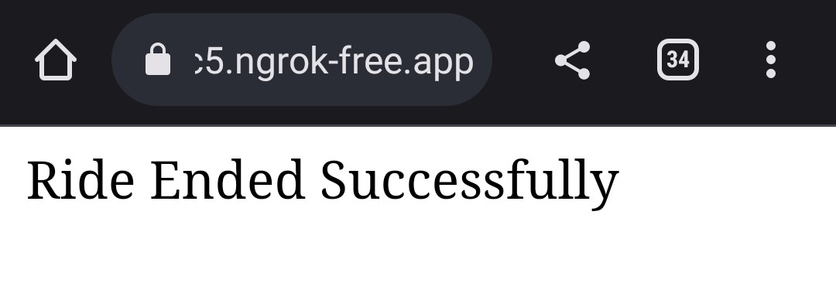
Step 6: End Ride
After Completing the Ride the driver get the OTP from the customer and ends the ride.
On Successful validation of the OTP the ride will be marked as completed.
The Thank You message and Rate us message will be sent to the user after the ride ends as mentioned in the previous slides.

Slide 19
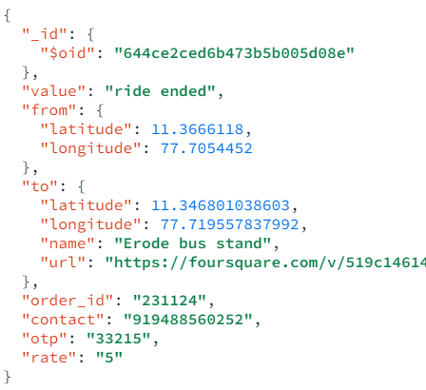
A Record in database
Each ride will have a record in the database which will contain the following attributes:
value indicating the status
from location
to location
order_id for ride no
contact has the customer phone no
otp to authenticate
rate - The rating given by the customer for the ride.

Slide 20
Conclusion
In conclusion, our auto booking solution via WhatsApp has the potential to revolutionize the transportation industry by providing a quick, efficient, and convenient way for customers to book rides. With the increasing popularity of messaging platforms such as WhatsApp, our solution is a timely and innovative solution that meets the needs of modern-day customers. The easy-to-use interface, automated confirmation and booking status updates make our solution a great option for anyone looking for a hassle-free way to book an auto-rickshaw.
Looking to the future, we believe that our auto booking solution via WhatsApp has great potential for further expansion and development. We plan to add support for multiple languages, integration with ride-sharing platforms, and expansion to other cities, adding payment options to it. Overall, we are excited about the future possibilities for our solution and look forward to continuing to innovate and improve the transportation industry.

Slide 21
Thank You

